Slide 1

Ministry of Investment, Trade & Industry
HALAL AUDITING TRAINING:
CU 1 & CU 2
HALAL TRAINING INSTITUTE (HTI)

Slide 2
TRAINING AGENDA
CU 1
Coordinate Pre-Audit Meeting
CU 2
Prepare Audit Tools
CU 3
Coordinate Opening Meeting
CU 4
CU 5
Carry Out Documentation Audit
Carry Out On-Site Audit
CU 6
CU 7
CU 8
Prepare Audit Finding Report
Carry Out Audit Closing Meeting
Conduct Follow Up Halal Audit

Slide 3
HALAL AUDITING – THE OBJECTIVES
To enhance the knowledge of key personnel in the organisation on the concept and required activities for Halal auditing program
To enhance knowledge on effective and efficient audit program
To enlightened and familiarise on elements or parameter for Halal Control System
To enhance capability to identify important and critical issues which may threaten Halal integrity

Slide 4
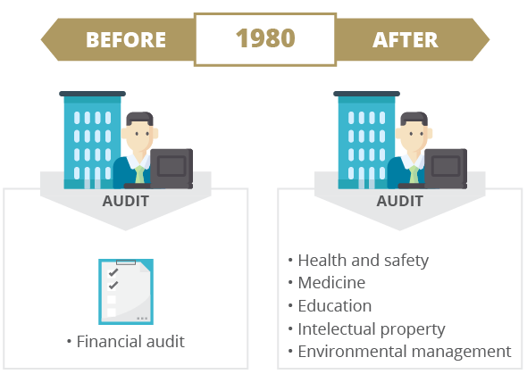
HISTORY AND CURRENT AUDIT TREND
When people think 'audit', people think 'financial’.
In 1980s, that chain of thought was put to a stop and a new audit trend was introduced; audit is no longer exclusive only for financial matters.
In fact, it extends to other fields such as health and safety, medicine, education, intellectual property and environmental management.

Slide 5
DEFINITION
ISO 19011
Audit is systematic independent and documented process for obtaining evidence and evaluating it objectively to determine the extent to which audit criteria is fulfilled.
Halal Internal Audit
A systematic and independent process for obtaining evidence and evaluating it objectively to determine the extent of compliance towards Halal Certification requirements.

Slide 6
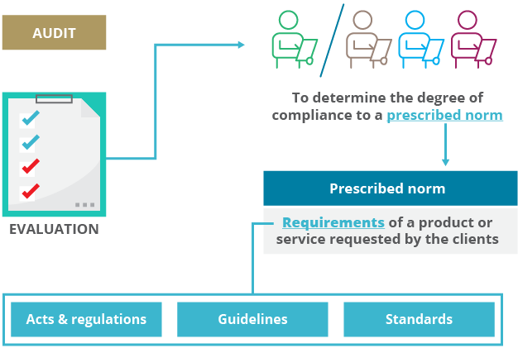
DEFINITION

Slide 7
Types of Audit
1st Party
2nd Party
3rd Party

Slide 8
INTERNAL AUDIT
GENERAL
An audit conducted inside the organization and by the organization’s own staffs to confirm to management that their documented system is working effectively.
FIRST PARTY AUDIT

Slide 9
External Audit
External audit is an audit conducted outside one’s own organization
Second Party Audit
Audit conducted by one company on another company to examine the ability to implement and in compliance with the contract requirements
Third Party Audit
Audit involving an independent body to which would certified companies as complying with the desired regulatory or standard.

Slide 10
SECOND PARTY AUDIT
Reasons for supplier audit:
provide comprehensive information for selecting, grading and approving the organization’s suppliers
increase confident and mutual understanding of halal requirements between organization and suppliers.
fulfil the requirement for Malaysia Halal Assurance System under General requirement for Raw Material Control

Slide 11
THIRD PARTY AUDIT
Audit involving an independent body to which would certified companies as complying with the DESIRED REGULATORY OR STANDARD.

Slide 12
OTHER TYPE OF AUDIT
CATEGORIZATION
Scope of audit and reason for conducting audit
Adequacy Audit
Compliance Audit
Surveillance Audit
Documentation Audit
On-site audit

Slide 13
ADEQUACY AUDIT
The availability, suitability and effectiveness of required documentation and records for implementation of a system or certification requirements
Example of required documentation :
Company policy, objective and scope
Procedures
We usually did not realise we
did this audit.

Slide 14
COMPLIANCE AUDIT
An audit to assess compliance to certification or system requirement
Conducted prior to certificate endorsement

Slide 15
SURVEILLANCE AUDIT
An audit to ensure an organization still meet the compliance towards certification or system requirement
Conducted after certificate endorsement

Slide 16
SITE AUDIT
Processing plant
Site of the processing activities

Slide 17
SITE AUDIT
Evaluating the current practices of plant or processing area for:
Core Processing Process flow
Physical infrastructure
Equipment and utensil
Personnel
Support system

Slide 18
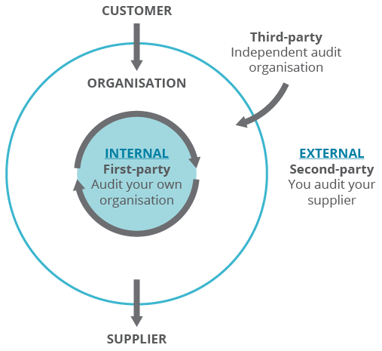
Audit Scope

Slide 19
IMPORTANCE OF AUDIT
Provides Assurance
departments & personnel within organization in compliance with the prescribed norm (certification requirements).
Enhance the efficient level
operational processes which help to reduce customer complaint

Slide 20
IMPORTANCE OF AUDIT
Define responsibility & authorities for key personnel
Current and organised documentation & records
Allocate appropriate resources for specific processes
Establish process owner
Systematic improvement in the cooperation between
department

Slide 21
IMPORTANCE OF AUDIT
POST AUDIT EFFECT
CONFIDENT
TRUST
SALES
PROFIT
POTENTIAL
DEMAND

Slide 22
Audit Principles What are audit principles?
Audit principle is also known as auditing characteristic.
Implementing audit principles prevents audit findings to be clouded with negative influences such biases, personal interest, threats, and unfairness due to bribery in term on monetary, career advancement, grudge, and others.
Therefore, adherence to the audit principles is a prerequisite for providing audit conclusion which are relevant and sufficient.
Adhering to the audit principles also enable each auditor within the audit team to reach a similar audit conclusion.

Slide 23
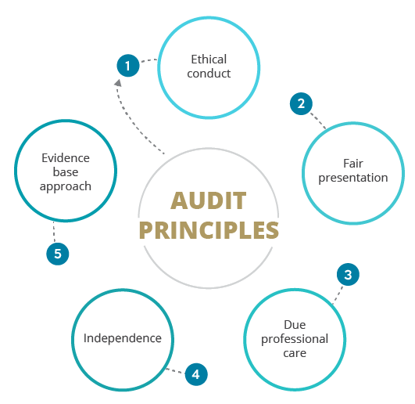
Audit Principles The importance of audit principles
Assist in ensuring the audit to become a reliable and effective tool for performance improvement
Assist in reaching similar and/ or standard audit finding and conclusion

Slide 24
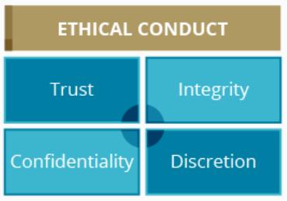
Audit Principles Ethical Conduct
Ethical conduct is a foundation of professionalism and must be applied by the auditor at all times. It is one of the core elements that need to be practiced by every auditor.
Under ethical conduct itself, there are 4 items which you will have to fulfill:

Slide 25
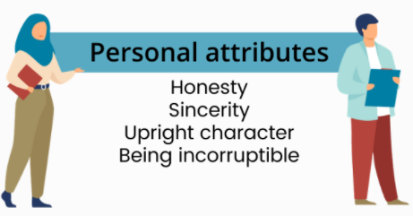
Audit Principles Ethical Conduct
Trust - Conducting audit in a professional manner, will develop trust in auditee. Thus, give rise to development of true information and facilitate conducive audit environment. Having trust results in achieving audit objective and improvement of business
Integrity

Slide 26
Audit Principles Ethical Conduct
Confidentiality
Safe guarding the audit findings – Data & Information
Shall not be disclosed in any manner including - Sharing in hard copy or soft copy of data or information & talking or speaking
Discretion
Demonstrate intelligence:
Demonstrate sound judgment
Ability to differentiate important/critical information during audit

Slide 27
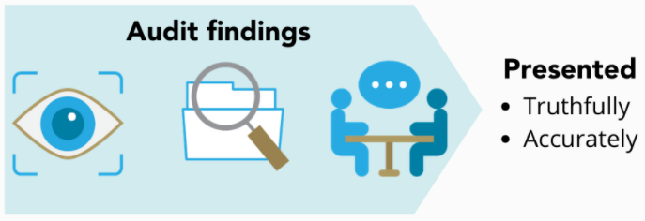
Audit Principles Fair Presentation
Fair presentation refers to the communication of the audit activities in the audit findings, audit conclusion and audit report, which are to be presented truthfully and accurately. It is also to include any arising issues in terms of obstacles and unresolved differences in opinion between the audit team and auditee.
Audit findings need to be a factual item of evidence relating to a specific requirement. The audit evidence needs to be appropriate and sufficient, this includes documentation/ recordings/ agreement with auditee.

Slide 28
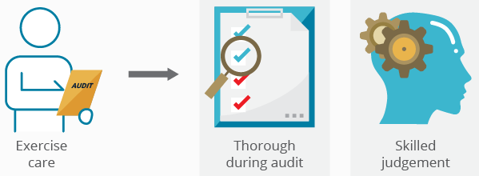
Audit Principles Due Professional Care
Due professional care is the application of diligence and judgement in auditing.
A skilled judgement is knowledge that you gain based on your general knowledge and specific knowledge.
This skill comes with experience and practice.

Slide 29
Audit Principles Independence
Independence is the basis for impartiality of the audit and objectivity of the audit conclusion. It is accessible to audit elements (information, personnel, audit site, cooperation and others) involved.
Audit activity is independent of auditor’s reporting superior.
The auditor practices an unbiased attitude free from personal interest issues and made no quality compromise in audit judgement.

Slide 30
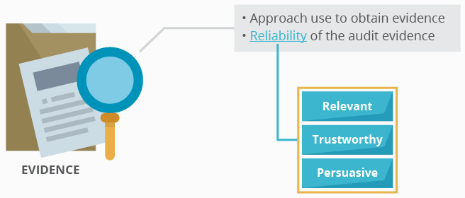
Audit Principles Evidence-based approach
Evidence-based approach is a rational method for reaching a reliable and reproducible audit conclusion in a systematic audit process.
The reliability of the evidence have to be relevant, trustworthy and persuasive.

Slide 31
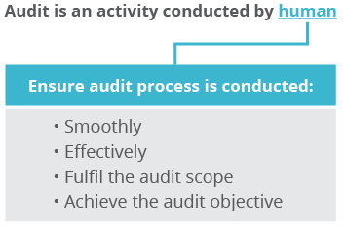
Your Audit Team
Auditor – The person with the competence to conduct audit:
The person who conducts the audit
Must have sufficient authority and accessibility
Should be independent of the function being audited
Should be objective when conducting audits
A successful audit process requires the auditor to manage his / her emotion in a manner that does not impose a negative impact on the audit process and the audit output.
For example, being angry or vindictive can cause a raise of inappropriate, biased and unfair judgement on the non-conformance identified.

Slide 32
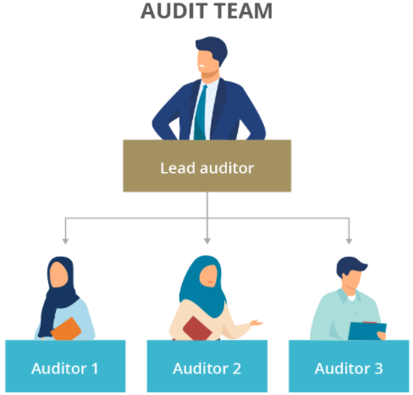
Auditor Responsibilities
In an audit team, there will be a lead auditor and a few other auditors on the team as shown.
The size of your team can differ according to the company size and their cases.
The roles and responsibilities of a lead auditor and the auditors under his/her leadership are different.

Slide 33
Auditor Responsibilities – Lead Auditor
Consulting with the auditee, if appropriate, in determining the criteria and scope of the audit
To establish the extent of the audit program
Identify and evaluate the risk for the audit program
Establish procedures for the audit program
Determine the necessary resources required and implementation for audit program – availability & accessibility:
Audit normative references
Audit documentation and records
Internal quality manual and records
Audit objective
Audit scope
Audit methods
Audit team selection & assessment

Slide 34
Auditor Responsibilities – Lead Auditor
Lead the audit team activity
Represent the audit team in discussion with the auditee prior to, during and after the audit
Act as a mediator if there is any arising issue among auditors and between auditor and auditee
Ensure that appropriate audit program records are managed and maintained

Slide 35

Auditor Responsibilities – Auditor
Following the direction of/ and supporting the lead auditor
Planning and carrying out the assigned task objectively, effectively and efficiently within the scope of the audit
Collecting and analyzing relevant and sufficient audit evidence to determine audit findings and reach audit conclusions
Preparing work documents under the direction of lead auditor
Safeguarding document pertaining to the audit and returning such documents as required

Slide 36
Auditor’s Personal Attributes What personal attributes does an auditor need to have?
Ethical
Being fair, truthful, sincere, honest and discreet
Open-minded
Willing to consider alternative ideas or point of views
Obtain all information and facts before forming a fair opinion or judgement
Perceptive
Being aware of and able to understand the situation
Able to gather information and sharp at observing surrounding situations or changes
Versatile
Being readily adaptable to different situations
Capable of functioning as multiple roles and multitasking functions competently
Resourceful

Slide 37
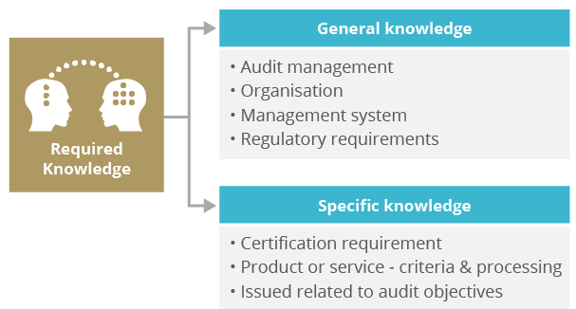
Auditor’s Required Knowledge
While discussing the audit principles needed for an auditor, we have also mentioned about how skilled judgment is part of a requirement in becoming an auditor. (Actually there are a lot of things that require a skilled judgement, but let's stick to this first)
Acquiring a skilled judgement can only come from your experience and practice of general and specific knowledge.

Slide 38
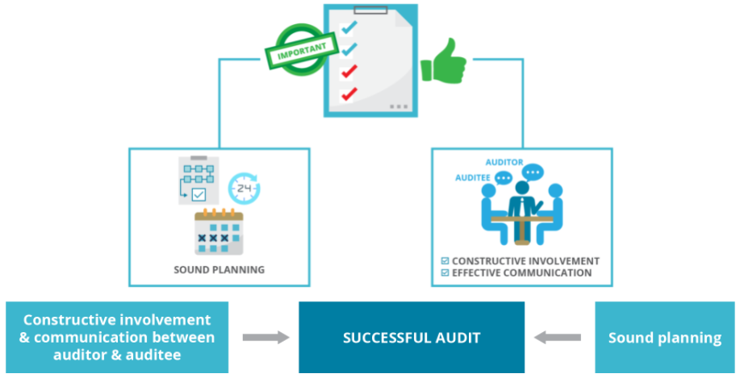
Audit in General
A successful audit is the result of sound planning and an atmosphere of constructive involvement and communication between auditor and auditee.
Basically, the audit process for any type of audit is similar and there are four stages, as shown in the audit cycle diagram.

Slide 39
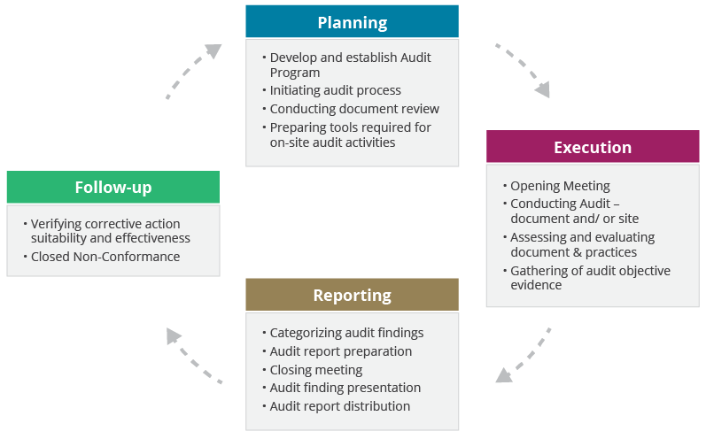
Audit Cycle
Audit cycle refers to the sequence of events which starts with planning, followed by execution, reporting and follow-up. Each of these processes comprises of activities as follows:

Slide 40
Audit Planning
Audit planning consists of 5 activities/steps as follows:
Step 1: Develop an audit program
Before you start developing an audit program, understand - What is an audit program?
Audit program is a collection of specific audits required to be conducted by an individual company, organization, agency or other entity with a policy of auditing to ensure compliance to a specific standard.

Slide 41
Audit Planning
Audit program content
To develop and establish your audit program, you have to identify:
Audit type
Audit objective and scope
Audit normative references
Selection of auditor and auditee
Frequency and schedule
Audit tools
Type and format of audit documentation
Audit process requirements
Audit method, Category of non-conformance, Corrective action, Follow up audit

Slide 42
Audit Planning
Step 2: Initiating Audit Process
Now that you have identified your audit process content, you can:
appoint and assign the auditors and formally notify them;
define the audit objective, scope and criteria;
contact the auditee formally to notify and confirm the arrangement.
Selection of audit team
In order for you to appoint and assign the auditors, you need to identify the size of the team and if the candidate fulfils the certification requirements. The team members & size is determined by the organization and the audit program.

Slide 43
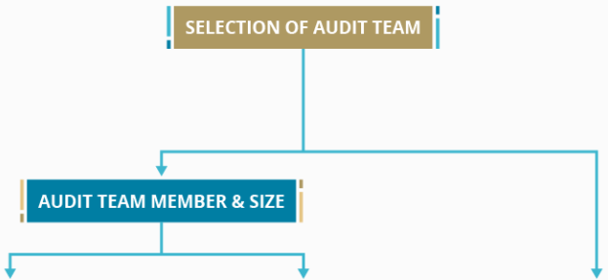
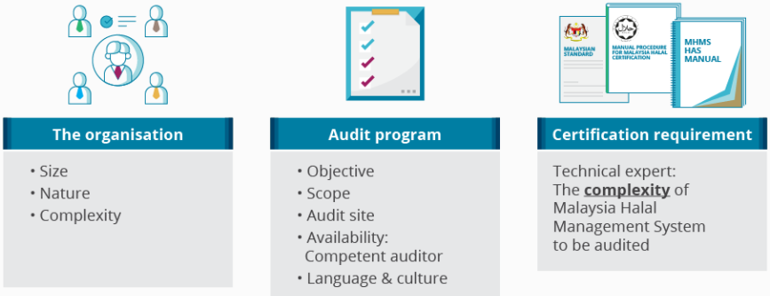

Slide 44
Audit Planning
Define audit objective
Audit objectives normally refer to the conclusion* that an identified audit is expected to draw in regards to the organization’s activity performance.
*Conclusion - Halal Certification Requirements (level of compliance & non-compliance)
Halal Internal Audit Objective
The purpose of this audit is to verify that the current HAS Manual is developed, implemented and updated according to the current Halal Assurance System (HAS), Halal Certification Manual Procedure and related Halal Standard in ensuring and maintaining integrity of Halal product/ service.

Slide 45
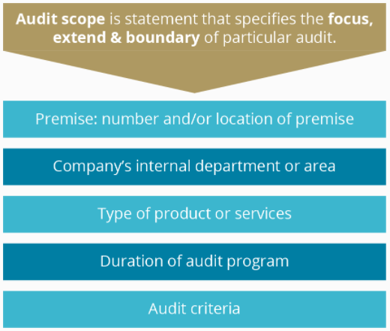
Audit Planning Audit Scope

Slide 46
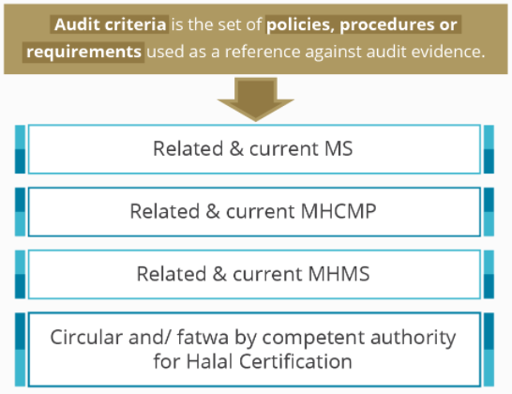
Audit Planning Audit Criteria
Contact the auditee, notify and confirm the arrangement

Slide 47

Audit Planning
Step 3: Conducting a document review
The chosen auditors must have a knowledge and understanding of the Halal Certification requirement and MHMS 2020 (HAS), as they need to discuss the product or service requirements in order to obtain the halal certification.
The objective of the document review
The objective of the document review is to establish a uniform identification and understanding of key and risky parameter/ information on halal certification requirement and Halal Control System that are involved.
Document review process
Identify the required parameter to comply.
Identify the required objective evidence to look for during the audit.
Identify the parameter which indicates compliance and non-compliance

Slide 48
Audit Planning
Step 4: Preparing the audit tools
Audit tools are used to facilitate on-site audit activities and/or to prevent contamination to the premise, process and product.
Audit tools include:
Personal Protective Equipment (PPE)
Tools or devices to use for observation and/or verification
Documentation for references, recording & reporting

Slide 49

Audit Planning

Slide 50

Audit Planning

Slide 51





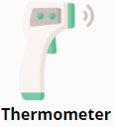






Audit Planning

Slide 52

Audit Planning
Prohibited materials during entering the audit client's premise and conducting audit

Slide 53

Audit Planning
Step 5: Audit work document
Audit work documents (as listed below) are part of the audit tools and are required to document and record the audit program.
Audit Plan
Audit Schedule*
Opening meeting agenda
Audit Checklist*
Audit Note
Audit Report*
Non-Conformance Report*
Closing meeting agenda
*Important documents

Slide 54
Audit Planning Audit Work Documents
These are some audit work documents that you will come across during course, a few documents you have to create and a few documents will be shared as a reference:
Audit checklist
Opening meeting agenda
Audit report
Non-conformance
Closing meeting agenda

Slide 55
Audit Planning - Audit Checklist
An audit checklist is a list of criteria that auditors refer to conducting an audit, prepared by the lead auditor and/or audit team members (auditor).
An audit checklist is one of the many tools used by the auditor to ensure that necessary halal standards and references are addressed; before, during and after the audit process.
Why do you need to create an audit checklist?
Serve as evidence that a halal internal audit has been conducted
Ensure that the audit is conducted systematically
Ensure a consistent audit approach
Actively support the organization's audit process
Act as a source of reference for notes collected during the audit as preparation of the closing meeting, audit report and corrective action request
Ensure uniformity in the performance of different auditors
Provide a reference to objective evidence

Slide 56
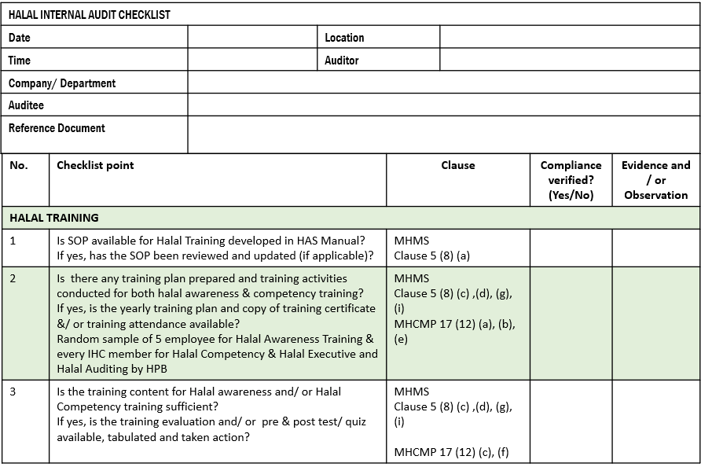
Example Halal Audit Checklist Format

Slide 57
Audit Planning - Audit Checklist Audit Evidence
In the audit checklist, there's a section where you need to fill in the audit evidence. But what is audit evidence?
Audit evidence refers to records, statements of fact or other information which are relevant to the audit criteria and is verifiable. The evidence is obtained based on the guide of HAS manual, Halal Risk Control SOP, work instructions, and the company records.
The evidence can also be in a form of posters, memo or signage.
Audit evidence is also information obtained during audit process through specific or combination of audit method. Information that supports and verifies compliance with MHCMP, MHMS, MS and maintain halal integrity of product/service.

Slide 58
Audit Planning - Audit Checklist Audit Evidence
The audit method to use in obtaining the evidence:
reviewing the company documentation
observation or demonstration
questioning or interview

Slide 59
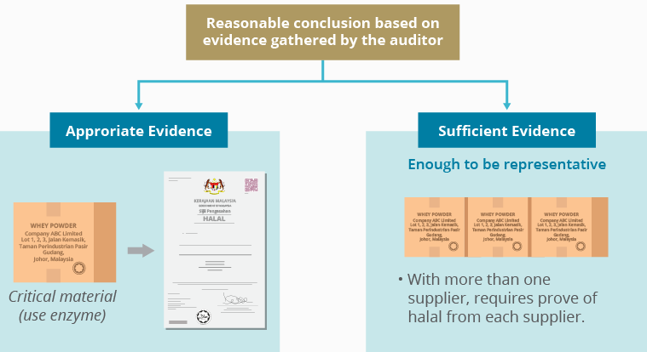
Audit Planning - Audit Checklist Audit Evidence
But how do you conclude that the evidence gathered are reasonable?

Slide 60
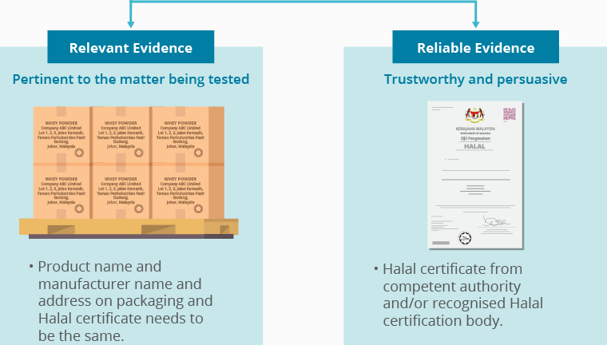
Audit Planning - Audit Checklist Audit Evidence

Slide 61
Audit Planning - Audit Checklist Developing Halal Audit Checklist
An audit is a sample check, where the quality of audit depends on the quality of the sample drawn during the audit.
In order to ensure the audit is smooth, systematic, consistent, uniform and achieve audit objective evidence, the following elements must be included in the audit checklist:
Audit criteria
Audit criteria checklist point
Related clause (s)
Audit method used
Audit evidence for compliance and non-compliance

Slide 62
Audit Planning - Audit Checklist Developing Halal Audit Checklist – Flow Diagram
Identify a requirement (audit Criteria) from the main reference
STEP 1
Halal Standards
Halal Certification Manual Procedure
Halal Assurance System
Define audit criteria important parameter (checklist point)
STEP 2
Define the method to achieve audit evidence:
STEP 3
Examine/inspect
Questioning / Interview
Observe / Demonstrate

Slide 63
Audit Planning - Audit Checklist Task: Develop Audit Checklist
As the company’s auditor, you need to create a checklist before conducting Halal Audit. The checklist is for Halal Training. Based on the given clauses related to Halal Training below, you are required to develop checklist questions to facilitate the Halal Internal Audit program and activities.
What you need to do:
You are to identify one requirement at a time from all the main references. This requirement is also known as the audit criteria (clauses from the main references).
Then define the audit criteria important parameter (audit checklist point) from all the main references and categorised them (Table 1).
After that, identify the audit method to use in obtaining audit evidence as proof of conformance and non-conformance (Table 2).
Finally, develop the audit checklist question (Table 3).
REFER: CLAUSES FROM MAIN REFERENCES–HALAL TRAINING

Slide 64
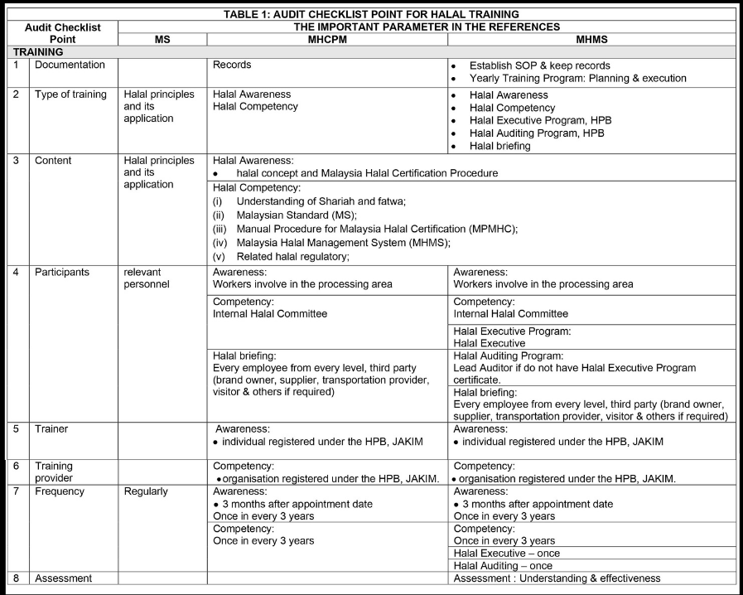
Audit Planning - Audit Checklist Task: Develop Audit Checklist – Sample Answer
Step 1: Categorised the audit criteria (Table 1)

Slide 65
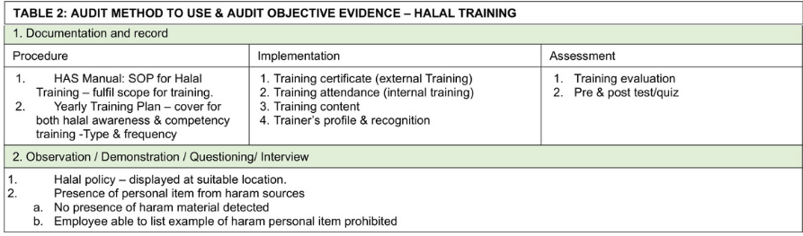
Audit Planning - Audit Checklist Task: Develop Audit Checklist – Sample Answer
Step 2: Identify the audit method to obtain audit evidence and the appropriate and sufficient audit evidence as prove of conformance and non-conformance. (Table 2)

Slide 66
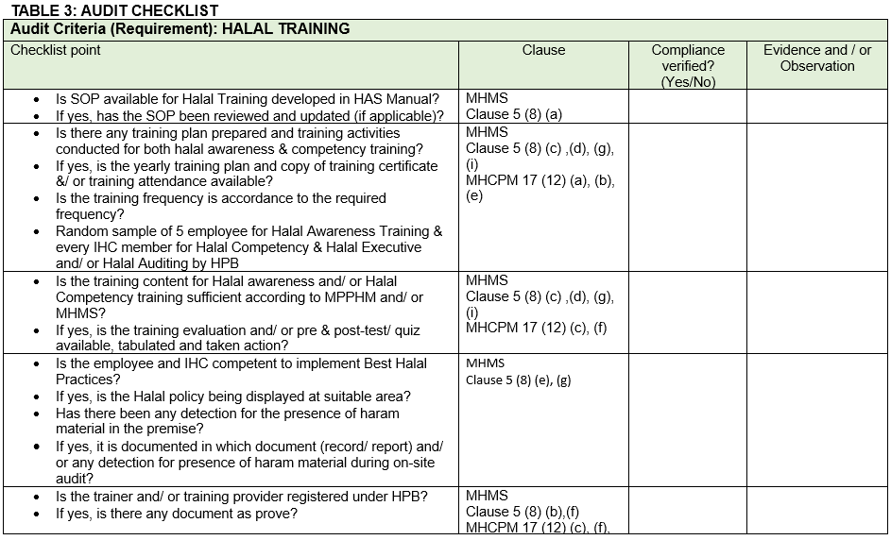
Audit Planning - Audit Checklist Task: Develop Audit Checklist – Sample Answer
Step 3: Develop the audit checklist question (Table 3)

Slide 67
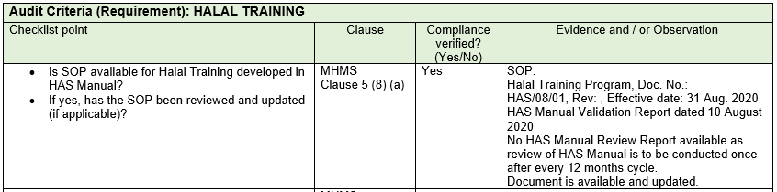
Audit Planning - Audit Checklist Task: Develop Audit Checklist – Sample Answer
Here's a sample of the audit checklist when in use

Slide 68
Audit Planning - Audit Checklist Task: Develop Audit Checklist
Develop audit criteria's important parameter (checklist point) for Halal Raw Material
As the company’s internal auditor, you need to create a checklist before conducting Halal Internal Audit. The checklist is for Halal Raw Material. Based on the given clauses related to Halal Raw Material given below, you are required to develop a checklist question to facilitate the Halal Internal Audit program and activities.
What you need to do:
You are to identify one requirement at a time from all the main references (MHCPM, MHMS, MS). This requirement is also known as the audit criteria (clauses from the main references).
Then, define the audit criteria important parameter (audit checklist point) from all the main references and categorise them (Table 1).
After that, identify the audit method to use in obtaining the audit evidence as prove of conformance and non-conformance (Table 2).
Finally, develop the audit checklist questions (Table 3).
REFER: CLAUSES FROM MAIN REFERENCES – HALAL RAW MATERIAL

Slide 69
Task: Develop Audit Criteria
Once you have analyzed the clauses for halal raw material, use the template given to develop the audit criteria's important parameter that suits the clauses for halal raw material.
Task: Identify & Develop Audit Method & Audit Objective Evidence
Based on the same scenario, you are to conduct step (2), which is to identify and develop audit method and audit objective evidence to obtain during an audit in Audit Checklist for halal raw material using the template given.
Task: Develop Audit Checklist Question
Finally, you are to develop audit checklist questions based on the audit criteria elements and the identified audit method, objective and evidence required for halal raw material.

Slide 70
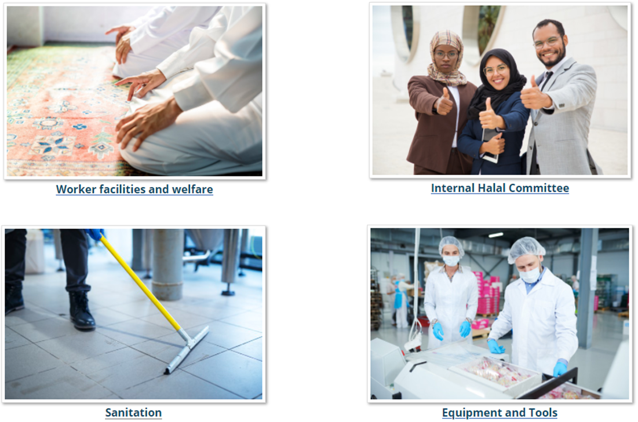
Audit Planning - Audit Checklist Task: Develop Audit Checklist
Great job! Now you are ready to create your own audit checklist. Here are some other options that you can work on. Try and develop the audit checklist's important parameter (checklist point) for these items.

Slide 71
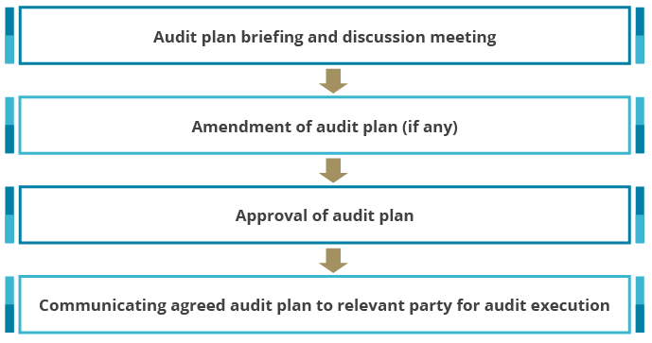
Audit Planning – Informing The Auditee
Contacting the auditee is the final stage in audit planning. The auditor has to communicate the audit plan to the auditee in a formal manner.
The diagram below shows the communication that should be done between the auditor and auditee during this stage.

Slide 72
Audit Planning – Informing The Auditee
Why do you need to inform the auditee?
To establish communication with auditee
To confirm the authority to conduct the audit
To provide information on the audit plan
To confirm the agreement regarding the extent of disclosure and the treatment of information confidentiality
Agreement for audit activities and schedules
Determine the specific requirement for access, security, health and safety and others
Agree on the attendance of team member for any accompanying personnel observer, trainee or guide
Refer : Opening Meeting Agenda & Halal Internal Audit Planning

Slide 73

www.hdcglobal.com

